Slide 1

Advanced C++ Banking System Thomas Hatt April 14, 2025

Slide 2

1. Use of Operator Overloading 2. Inheritance and Polymorphism 3. Linked Lists and Special Classes 4. Templates for Generic Programming 5. Extensive Exception Handling
Features of my Banking System

Slide 3

Program Table of Contents
Section 1: Generic Banking Classes (Parent Classes)
Section 2: Overridden Classes (Spending, Reserve, and Growth Accounts)
Section 3: Transaction Management
Section 4: Financial Management
Section 5: Store System
Section 6: Templates
Image by Dylan Leagh from Pixabay

Slide 4
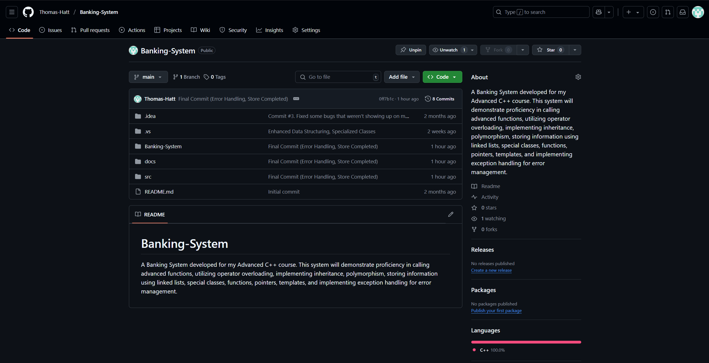
GitHub Link
https://github.com/Thomas-Hatt/Banking-System

Slide 5
System Architecture
Part 1
This banking system is designed for optimal account management, validation, and transactions using advanced C++ coding practices. It organizes Spending, Reserve, and Growth accounts using a linked list data structure, managed by the AccountList class, to maintain a dynamic collection of accounts. Each account type inherits from the base Bank_Account class, allowing for features such as transaction limits (Spending_Account) and interest calculations (Growth_Account and Reserve_Account)

Slide 6
System Architecture
Part 2
The system incorporates a store system, encapsulated within the Store class, which simulates a small section of real-world spending by allowing users to make purchases, integrating my banking functionalities with lifelike transactions. This integration is created through methods that access and modify account balances based on purchase transactions.

Slide 7
System Architecture
Part 3
To ensure robustness, the system uses C++ templates (NumericUtils, StringValidationUtils, StringLengthValidator) for generic programming, providing type safety and reusability across different data types and validation scenarios. Error handling is implemented through input validation functions that utilize regular expressions (regex) and custom validation logic to ensure data integrity.

Slide 8
System Architecture
Part 4
Account creation, updates, and transaction processing are managed through dedicated functions and methods within the AccountList and individual account classes. The system uses a combination of std::cin and custom validation functions to ensure user inputs meet predefined criteria, ensuring system reliability.

Slide 9
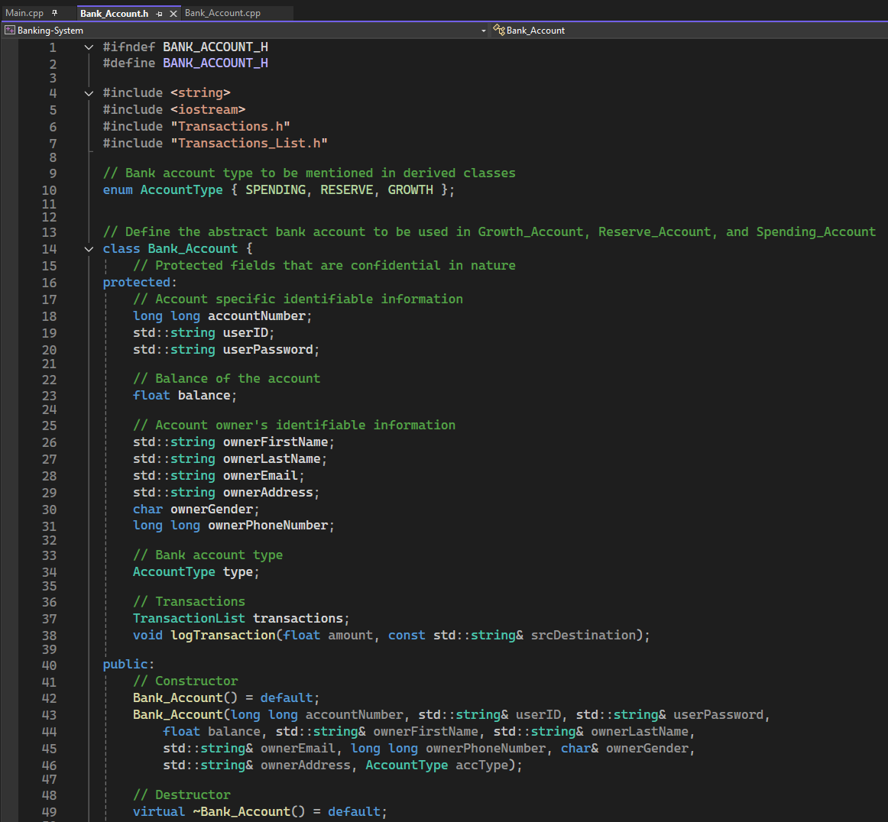
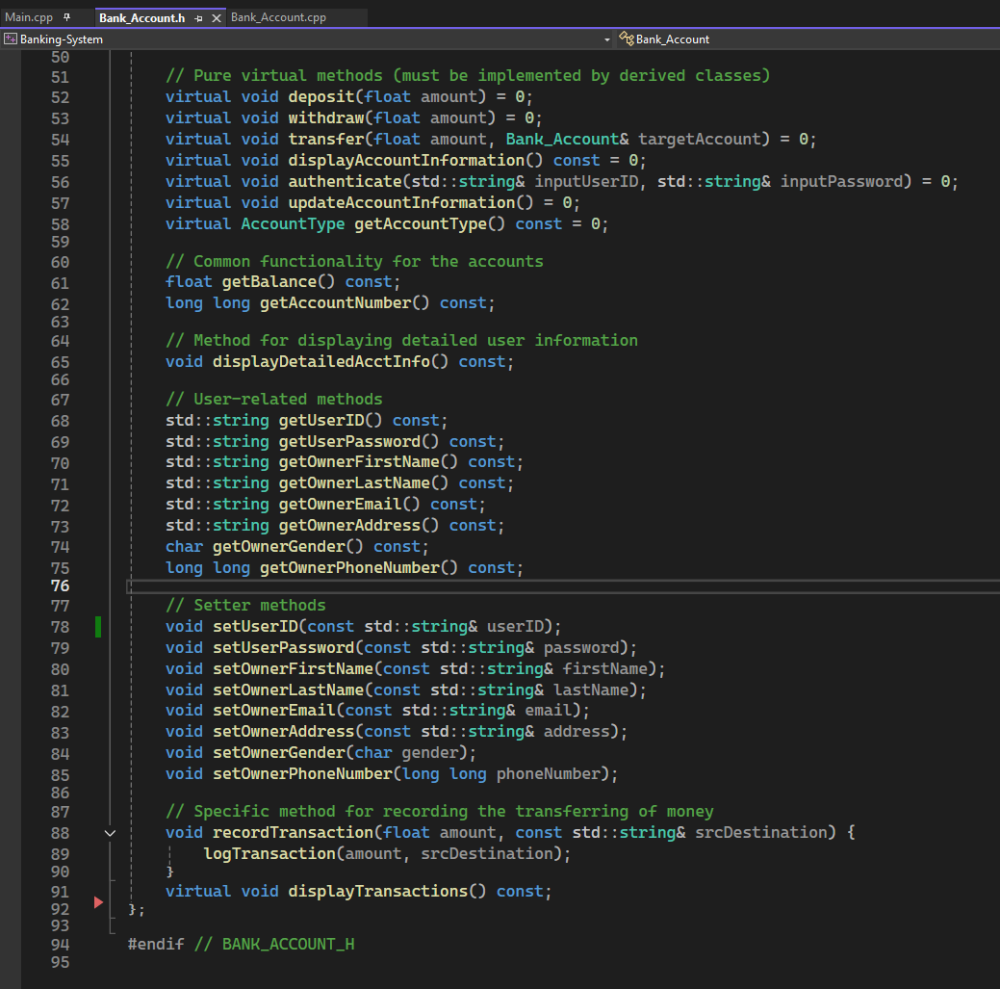
Section 1 Slide 1/4 Bank_Account.h part 1

Slide 10
Section 1 Slide 2/4 Bank_Account.h part 2
Main Points:
Bank_Account.h is an Abstract Class to be inherited by Spending, Growth, and Reserve Accounts
Includes Account Details, such as User ID, Account Number, and User Password (protected fields)
Includes Account Owner’s Details, such as Name, Address, and Phone Number
Includes Transaction Management (relies on Transactions.h/cpp and Transactions_List.h)
Pure Virtual Methods (must be overridden by derived classes) which includes core operations, account management, and account type identification
Getters and Setters, and a way to view the account information

Slide 11
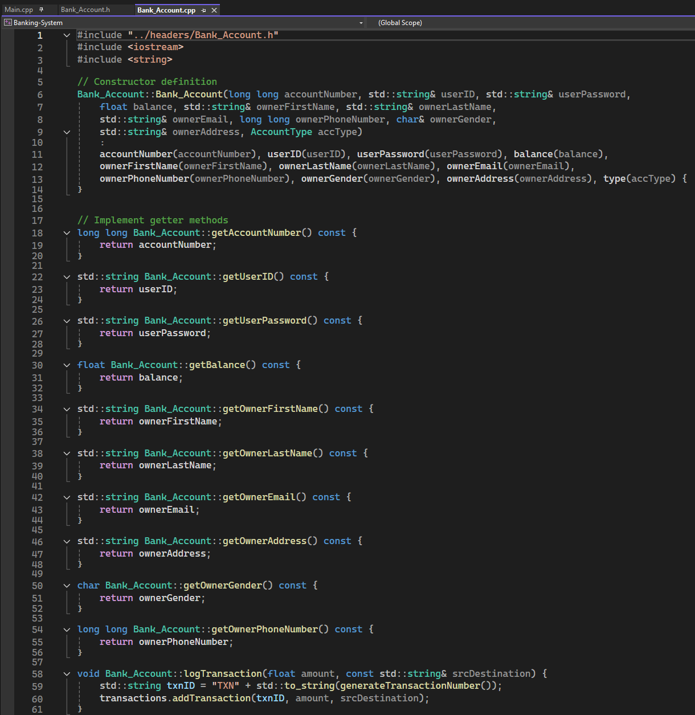
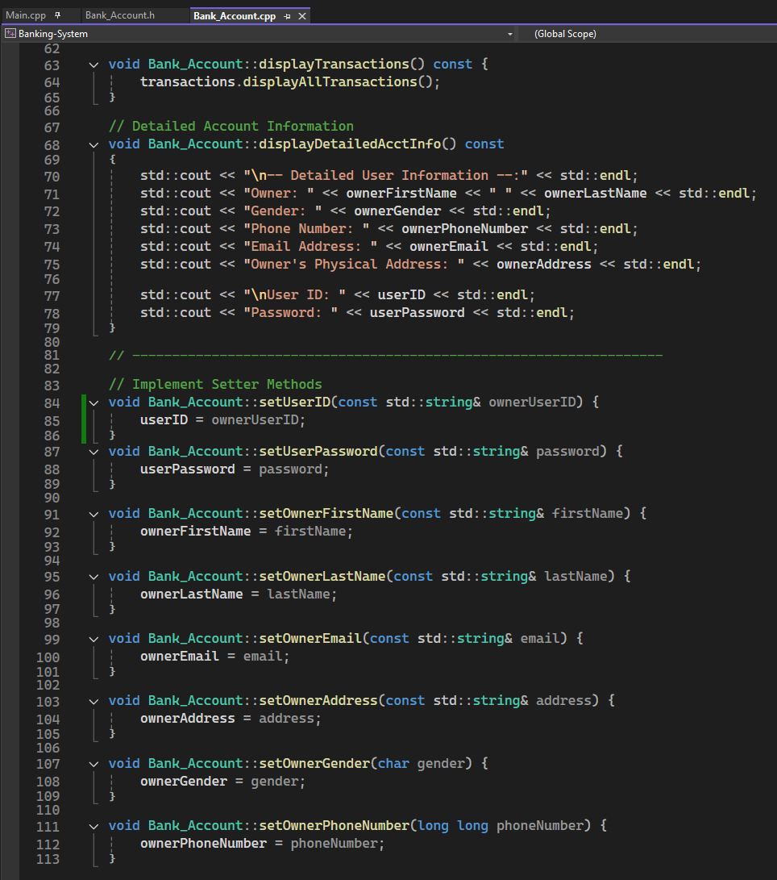
Section 1 Slide 3/4 Bank_Account.Cpp part 1

Slide 12
Section 1 Slide 4/4 Bank_Account.CPP part 2
Main Points:
Bank_Account.cpp uses a member initializer list to set all the fields (Account Number, User ID, etc.)
Simple Accessors, does not include any specific logic. For example, getBalance() returns the balance (which is a float)
Generates a transaction ID ("TXN-5186102674" using generateTransactionNumber()).
Displays Transactions for all accounts (implemented in Transactions_List.h)
Displays all Account Information (User ID, Name, Address)
Basic updates to information

Slide 13
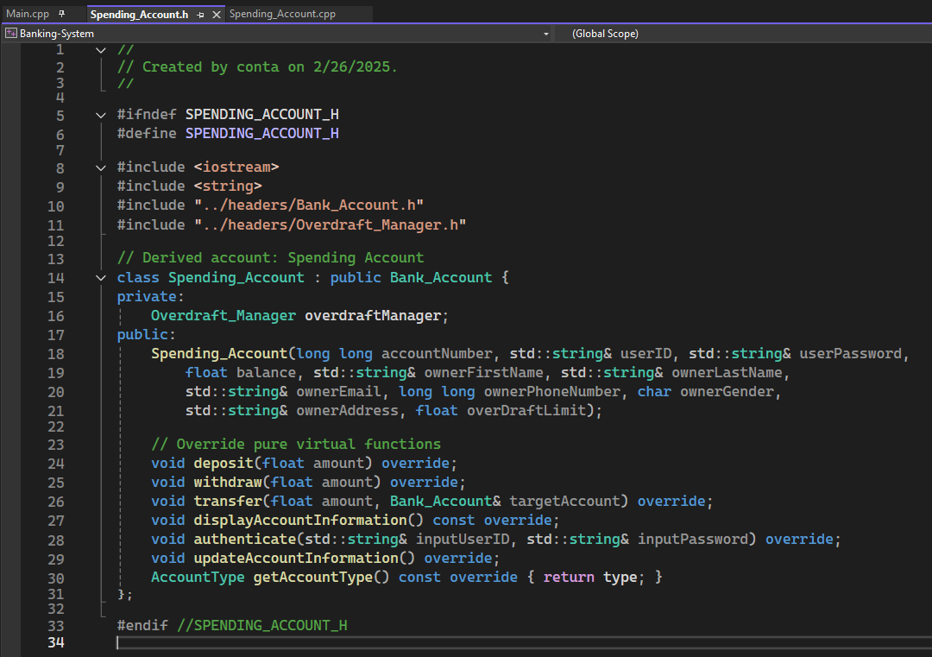
Section 2 Slide 1/7 Spending_Account.h part 1

Slide 14
Section 2 Slide 2/7 Spending_Account.h part 2
Main Points:
Spending_Account.h is derived from Bank_Account
Includes Account Details, such as Account Number, User ID, User Password, and Overdraft Limit
Includes Account Owner’s Details, such as Name, Address, and Phone Number
Methods override virtual functions from Bank_Account to implement spending-specific logic

Slide 15
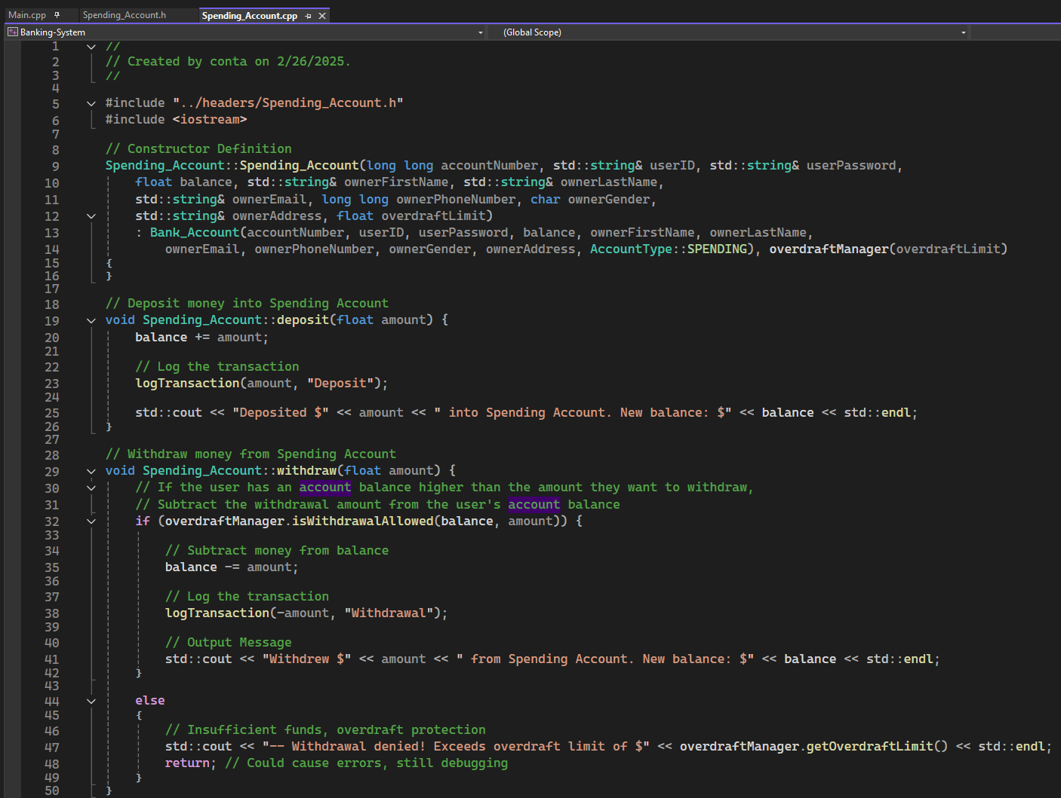
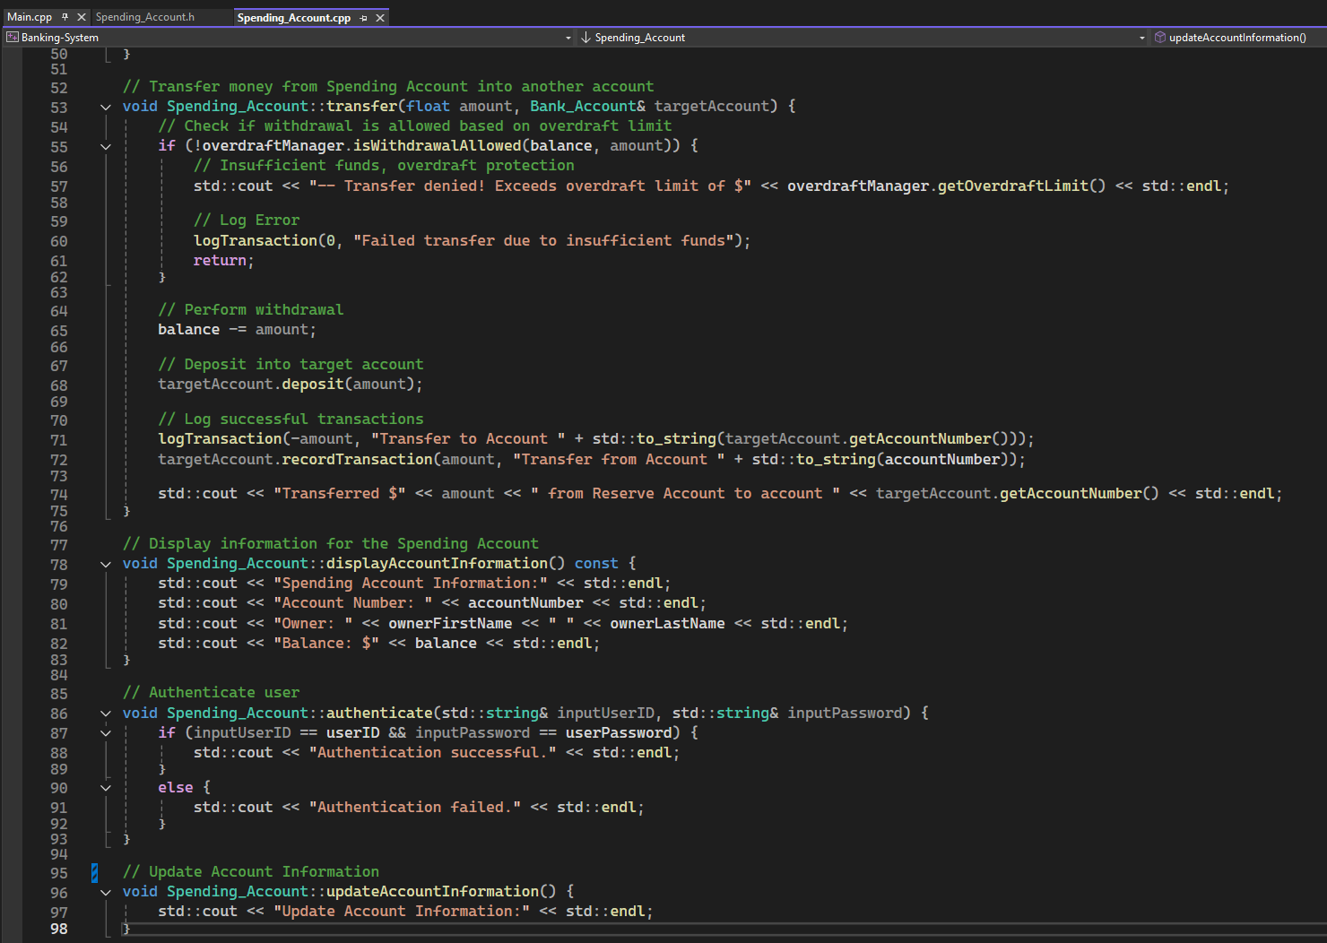
Section 2 Slide 3/7 Spending_account.Cpp part 1

Slide 16
Section 2 Slide 4/7 Spending_account.Cpp part 2
Main Points:
Bank_Account.cpp Calls base class (Bank_Account) constructor for common properties.
Initializes Spending_Account with account details and overdraft limit.
Initializes overdraftManager with the specified limit.
Implements deposit logic to add money into the account, then logs the transaction.
Implements withdrawal logic to withdraw money from the account, using overdraftManager to ensure it doesn't give the user negative balance.
Implements transfer logic to allow the user to transfer money from one account to another account. Also checks through overdraftManager to ensure proper handling
Displays basic account details (account number, owner name, balance).
Authenticates user by checking User ID and password.

Slide 17
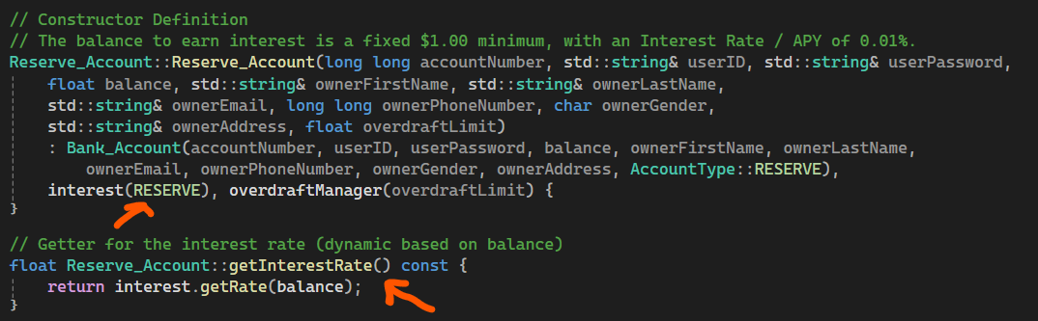
Section 2 Slide 5/7
It’s important to note that Spending, Reserve, and Growth accounts are nearly identical.
There is 1 main exception to this fact:
Reserve and Growth accounts have an added interest rate that accrues throughout time.

Slide 18
Section 2 Slide 6/7
You may be wondering, “where did you find the information to base the numbers on?”
The simple answer to this question is that I modeled it after the banking system that I personally use (PNC Bank).
https://www.pnc.com/content/dam/pnc-com/pdf/personal/Checking/VW_Student_fees.pdf
https://www.pnc.com/en/rates/virtual-wallet/33414/NA

Slide 19
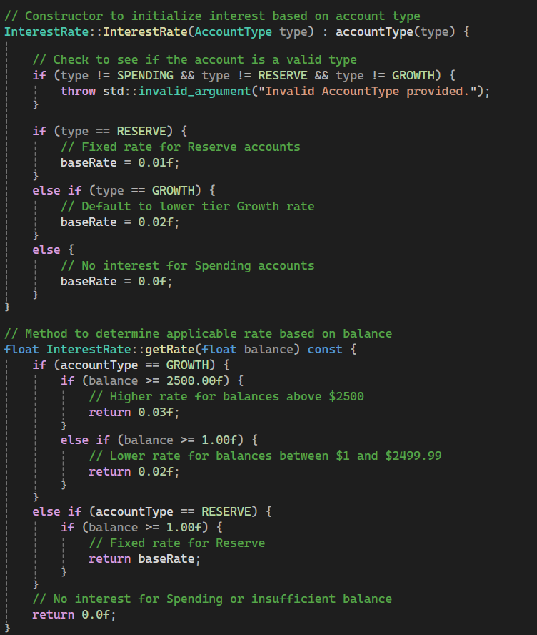
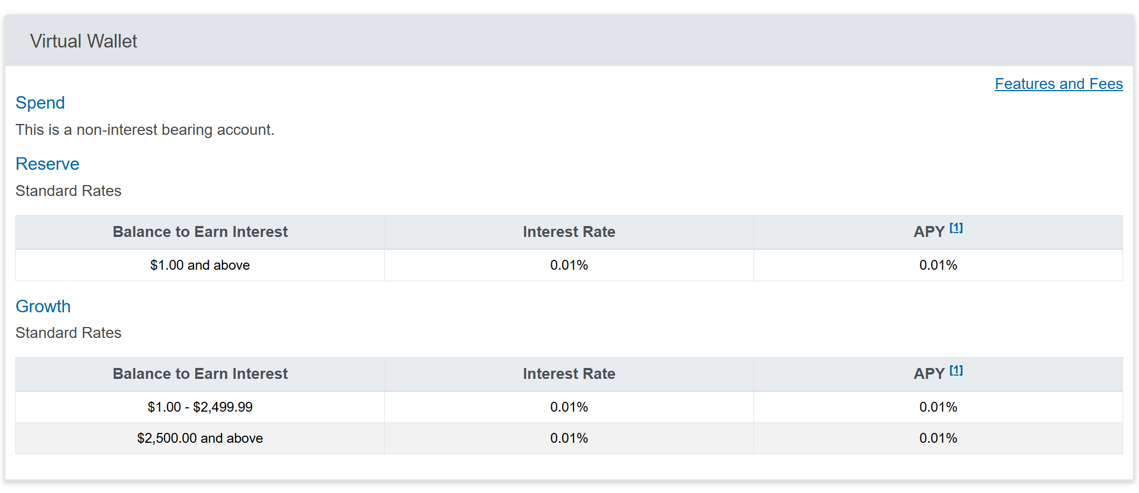
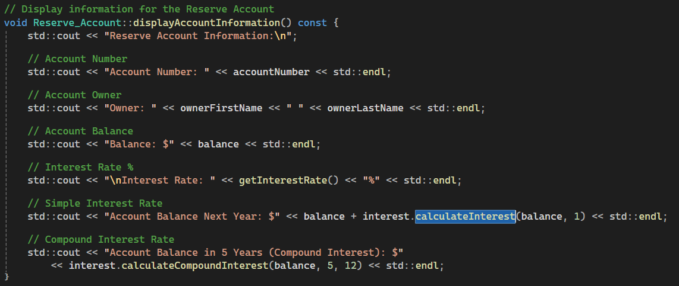
Section 2 Slide 7/7
My Code
V
Official PNC Bank Numbers
V V V V
I used these exact numbers in my program!

Slide 20
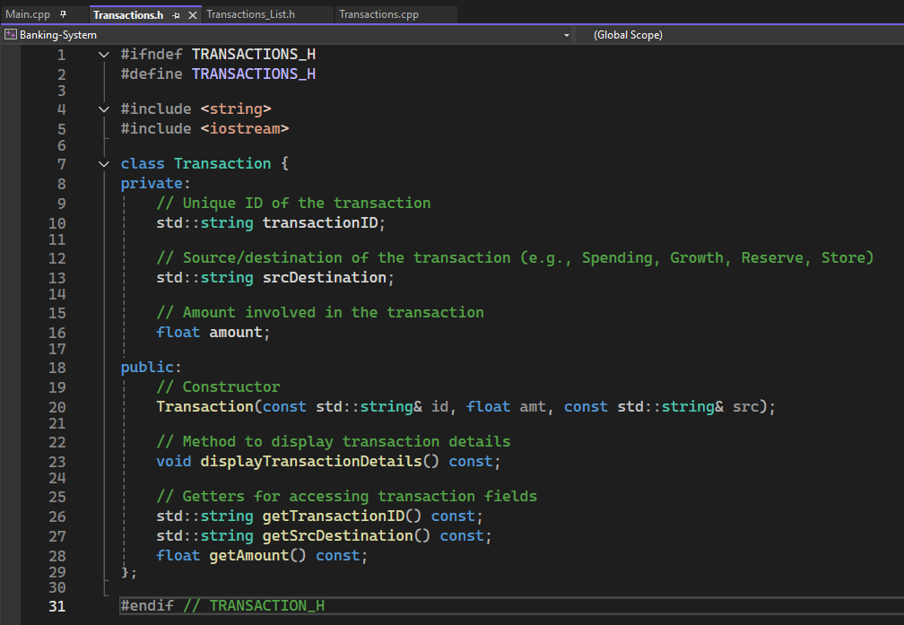
Section 3 Slide 1/4 Transactions.h
Transactions.h
Defines the Transaction class for tracking financial transactions.

Slide 21
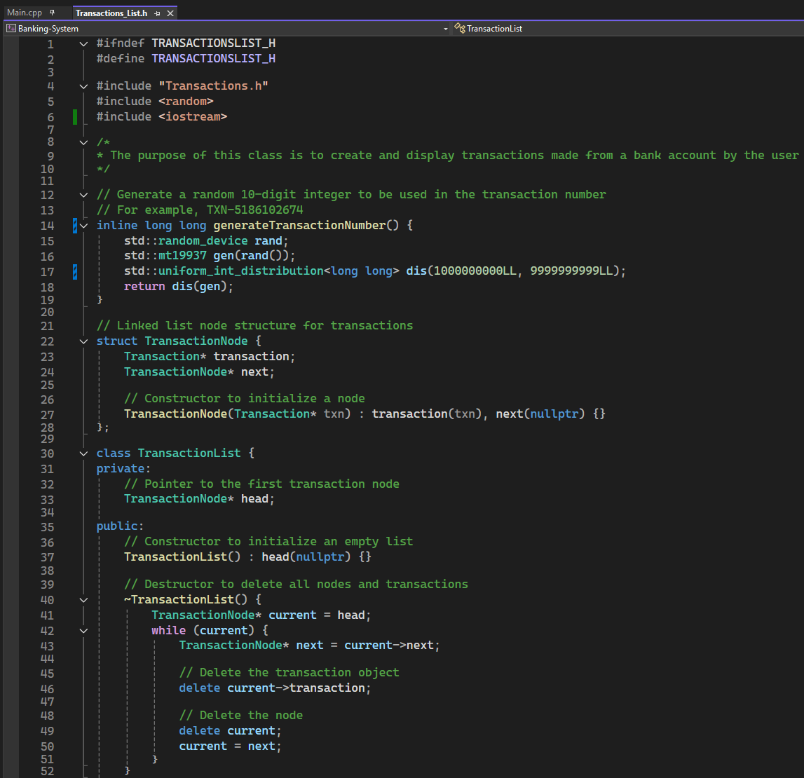
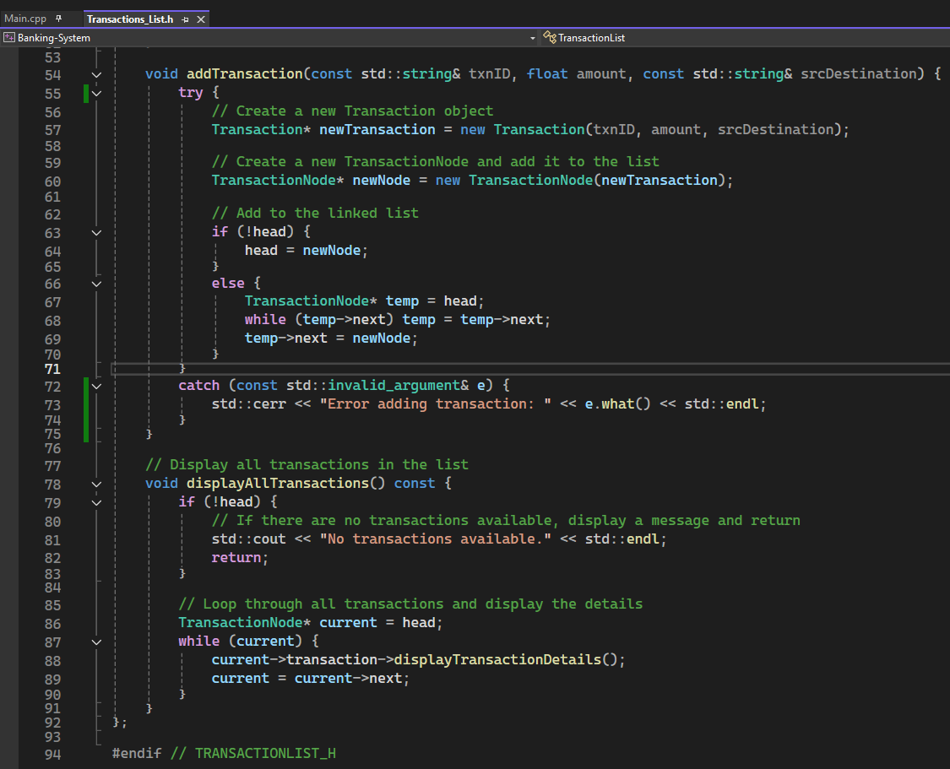
Section 3 Slide 1/4 Transactions_LIST.h part 1

Slide 22
Section 3 Slide 1/4 Transactions_LIST.h part 2
Transactions_List.h
1. Defines the ability to create, assign, and display banking transactions using a linked list structure.
2. Each transaction is assigned using a randomly generated 10-digit number
(for example, “TXN-5186102674”)
which is added whenever a banking action is performed (withdrawal, transfer, deposit)

Slide 23
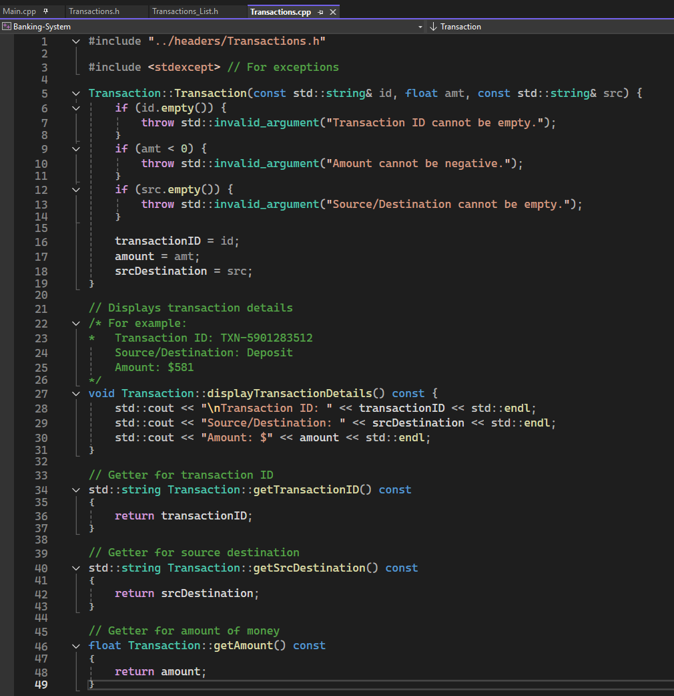
Section 3 Slide 1/4 Transactions.cpp
Transactions.cpp
Allows for transactions to be displayed with a base message, includes a getter for the transaction ID, the source of the transaction, and the amount of money involved.
There is also error handling for certain events.

Slide 24
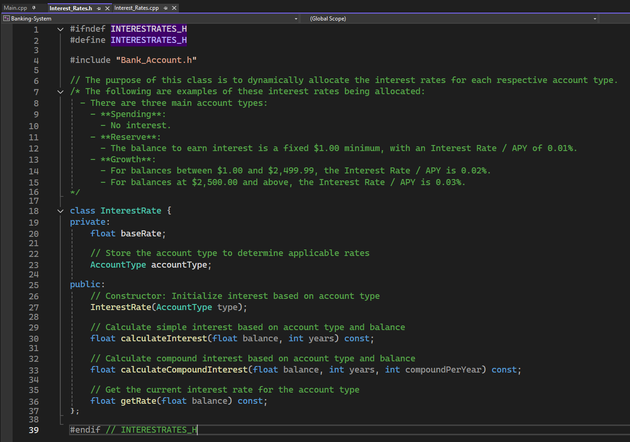
Section 4 Slide 1/4 Interest_Rates.h part 1

Slide 25
Section 4 Slide 1/4 Interest_Rates.h part 2
Main Points:
Purpose: Dynamically allocate interest rates for different account types.
Account Types & Interest Rates:
Spending: No interest.
Reserve:
Minimum balance to earn interest: $1.00.
Interest Rate / APY: 0.01%.
Growth:
Balance $1.00 $2,499.99: Interest Rate / APY 0.02%.
Balance $2,500.00 and above: Interest Rate / APY 0.03%.
Class: InterestRate:
Stores base interest rate.
Stores account type for applicable rates.

Slide 26
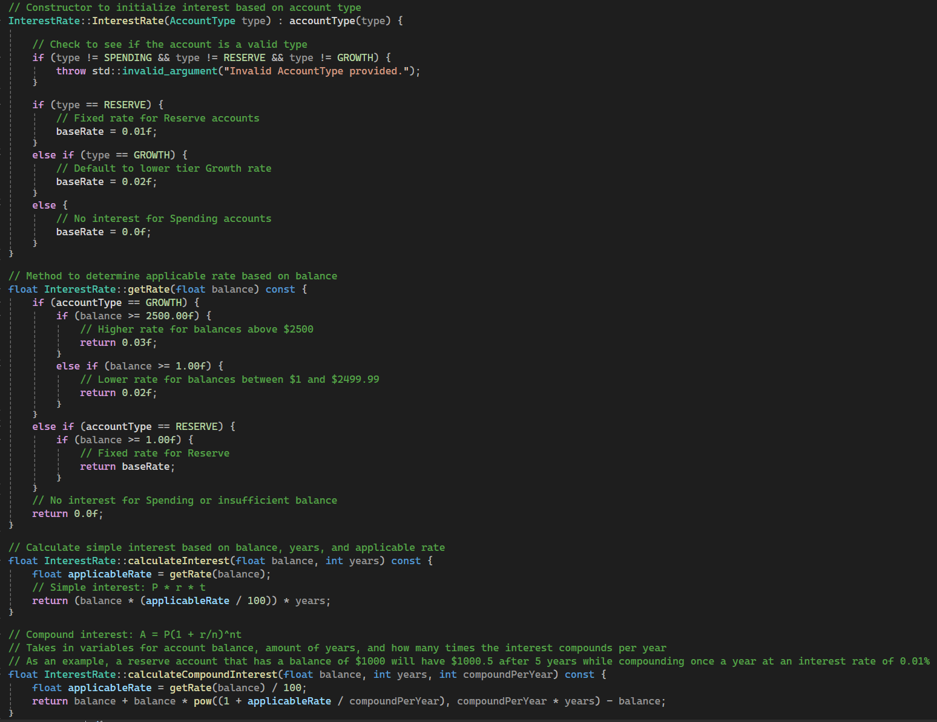
Section 4 Slide 1/4 Interest_Rates.cpp part 1

Slide 27
Section 4 Slide 1/4 Interest_Rates.cpp part 2
Method: getRate(float balance)
Determines applicable interest rate based on balance and account type:
1. Growth:
≥ $2,500.00 → 0.03%.
$1.00 $2,499.99 → 0.02%.
2. Reserve:
≥ $1.00 → Fixed 0.01%.
Spending or insufficient balance → 0.0%.
Method: calculateInterest(float balance, int years)
Computes simple interest using formula:
Interest = Balance × (Rate / 100) × Years.
Method: calculateCompoundInterest(float balance, int years, int compoundPerYear)
Computes compound interest using formula:
A = P(1 + r/n)^(nt).
Example:
Reserve account with $1000 balance compounding annually at 0.01% →
$1000.50 after 5 years.

Slide 28
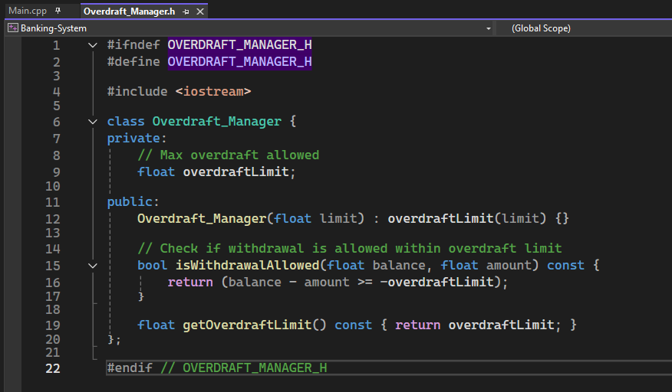
Section 4 Slide 1/4 Overdraft_Manager.h part 1

Slide 29
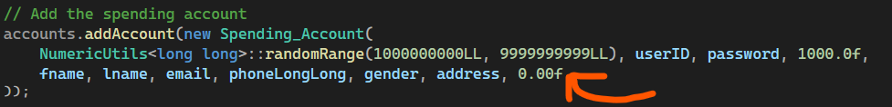
Section 4 Slide 1/4 Overdraft_Manager.h part 2
Bank account balance Cannot go below 0.00f

Slide 30
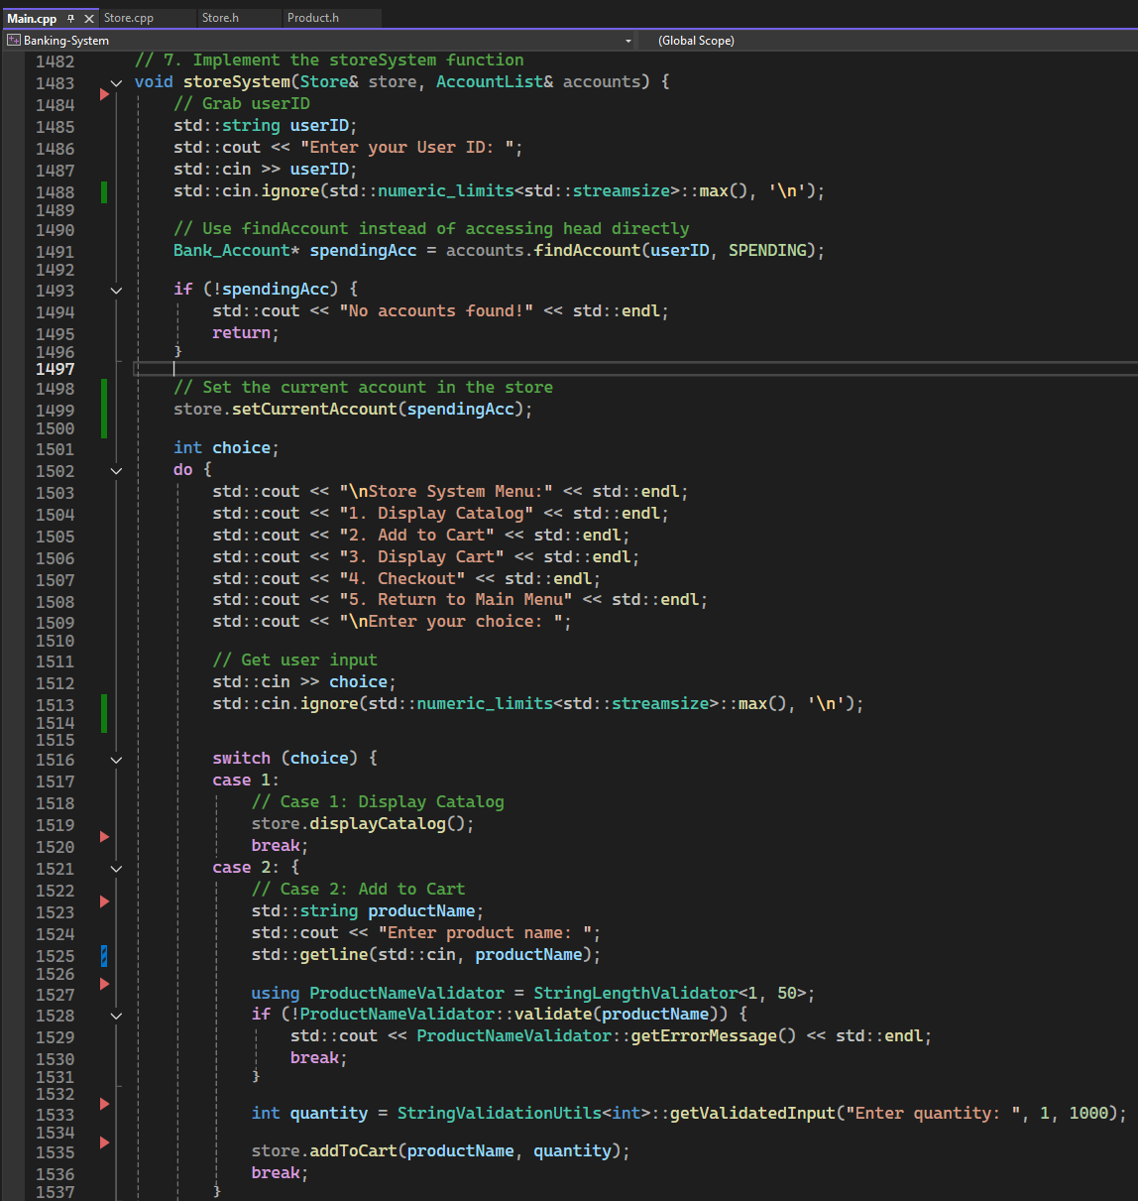
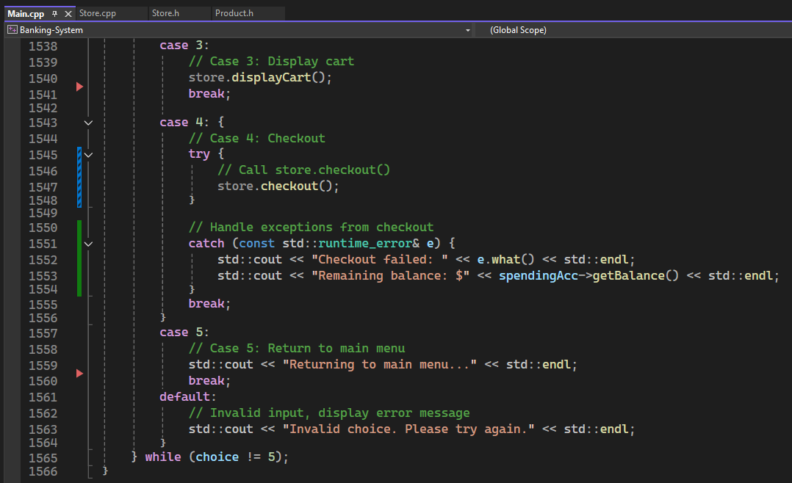
Section 5 Slide 1/13 Main.cpP part 1

Slide 31
Section 5 Slide 2/13 Main.cpP part 2
Store Menu Loop:
Presents the Store System Menu, which allows the user to interact with store functions. Repeats until the user selects Return to Main Menu.
Menu Options:
Display Catalog: Calls "store.displayCatalog()" to show available products.
Add to Cart:
Prompt user for a product name.
Validate input using "StringLengthValidator<1, 50>".
Prompt for quantity, ensuring valid input using "StringValidationUtils<int>::getValidatedInput()".
Display Cart:
Calls "store.displayCart()" to list selected items.
Checkout:
Calls "store.checkout()", handling potential runtime errors.
If checkout fails, display an error and the remaining account balance.
Return to Main Menu:
Ends store interaction and returns control to the main menu.

Slide 32
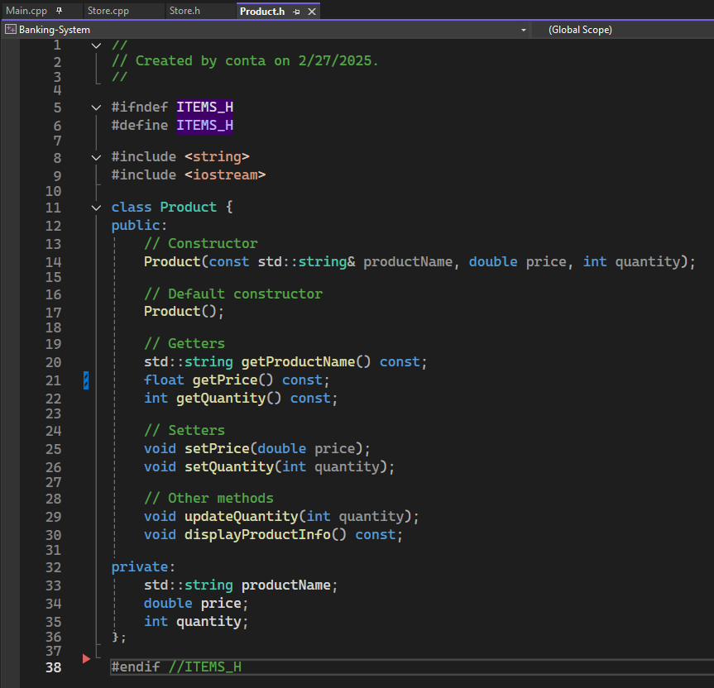
Section 5 Slide 3/13 Product.h part 1

Slide 33
Section 5 Slide 4/13 Product.h part 2
Product Class Overview:
Defines a product with attributes and methods for store operations.
Attributes:
productName: Stores the name of the product.
price: Represents the cost of the product.
quantity: Tracks available stock.
Constructors:
Default and parameterized constructors for object initialization.
Methods:
Getters & Setters: Retrieve and modify product details.
updateQuantity(): Adjusts stock levels.
displayProductInfo(): Prints product details to the console.

Slide 34
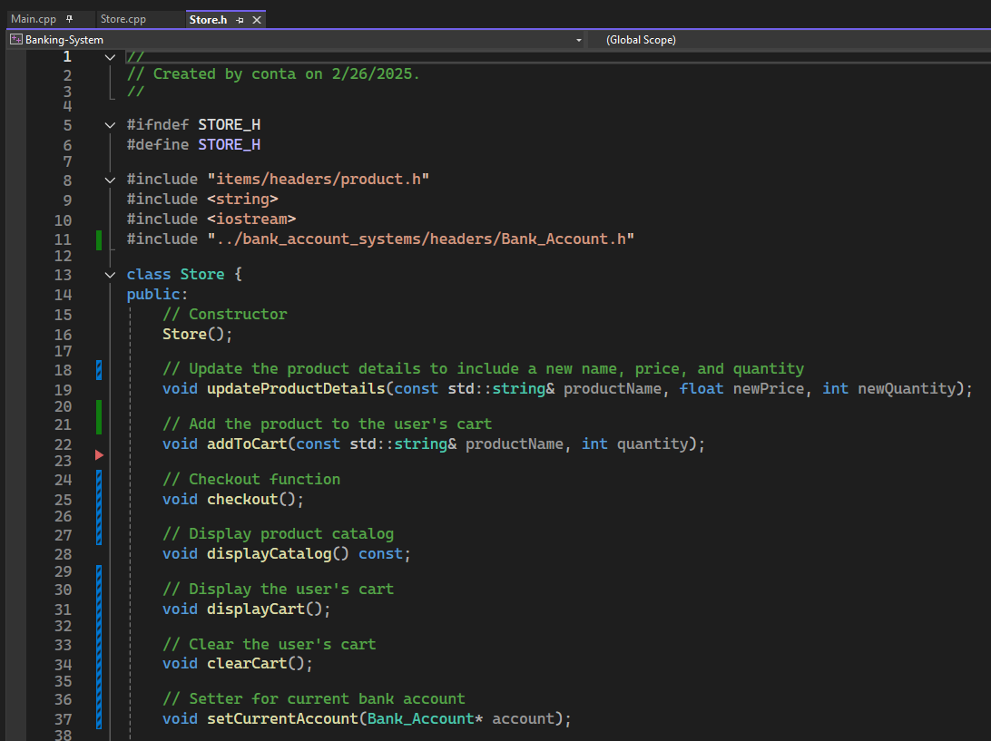
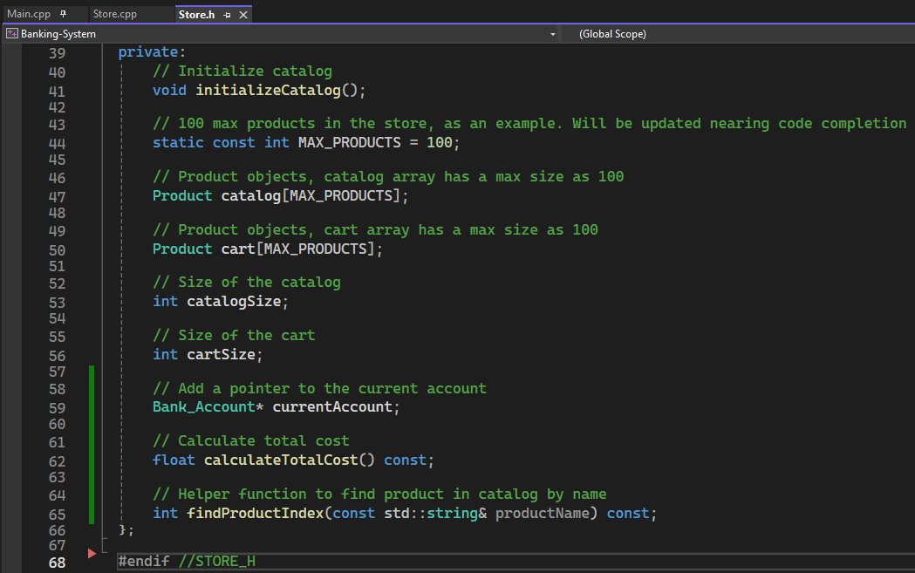
Section 5 Slide 5/13 Store.h part 1

Slide 35
Section 5 Slide 6/13 Store.h part 2
Store Class Overview:
Manages store operations, including product inventory, shopping cart, and transactions.
Product Management:
Update product details, store inventory, and catalog initialization.
Shopping Cart:
Add items, display contents, and clear cart.
Checkout:
Process purchases, linking transactions to a bank account.
Account Integration:
Set current user’s bank account for transactions.
Utility Methods:
Calculate total cost and find products in the catalog.

Slide 36
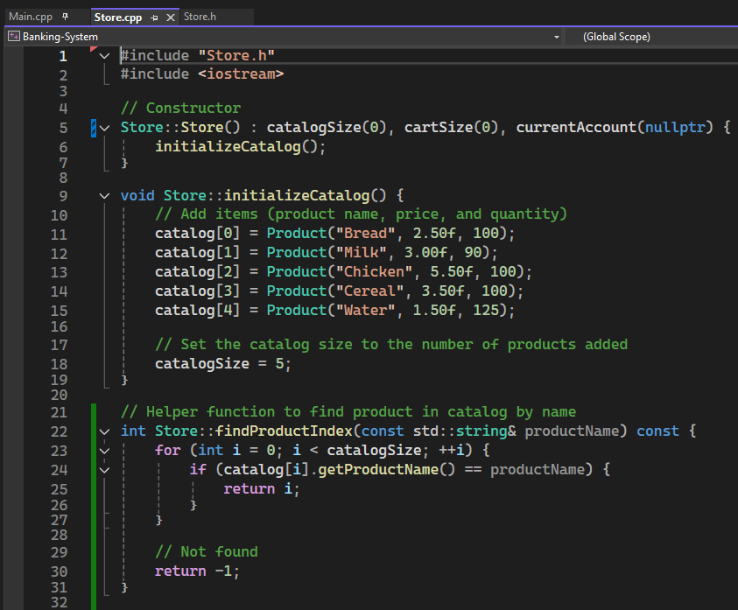
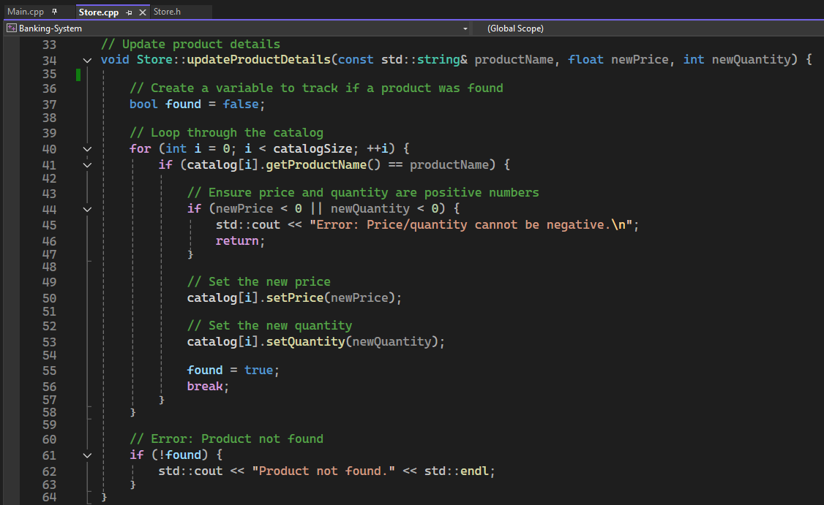
Section 5 Slide 7/13 Store.cpp part 1

Slide 37
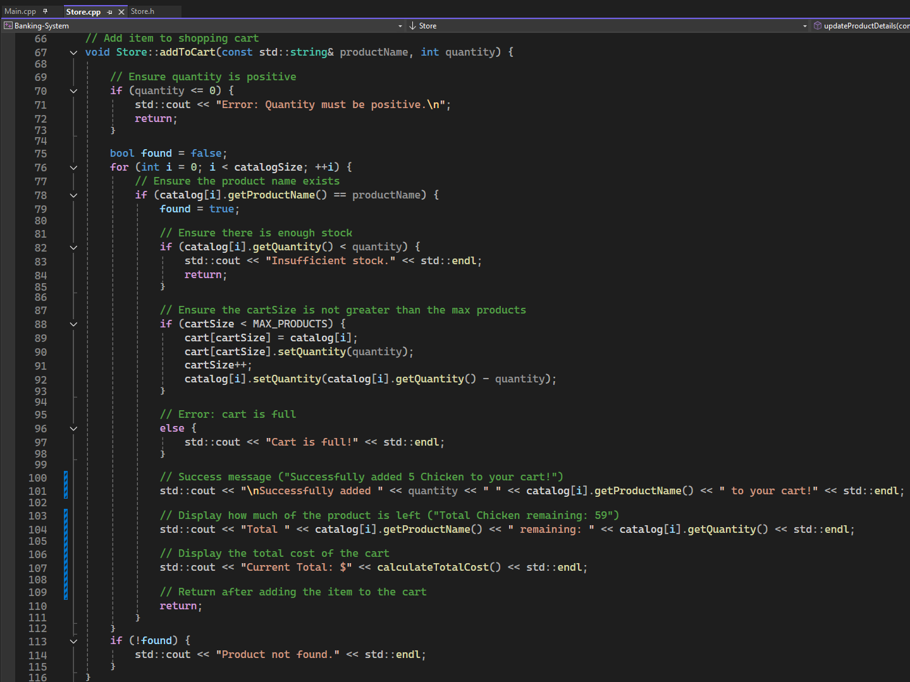
Section 5 Slide 8/13 Store.cpp part 2

Slide 38
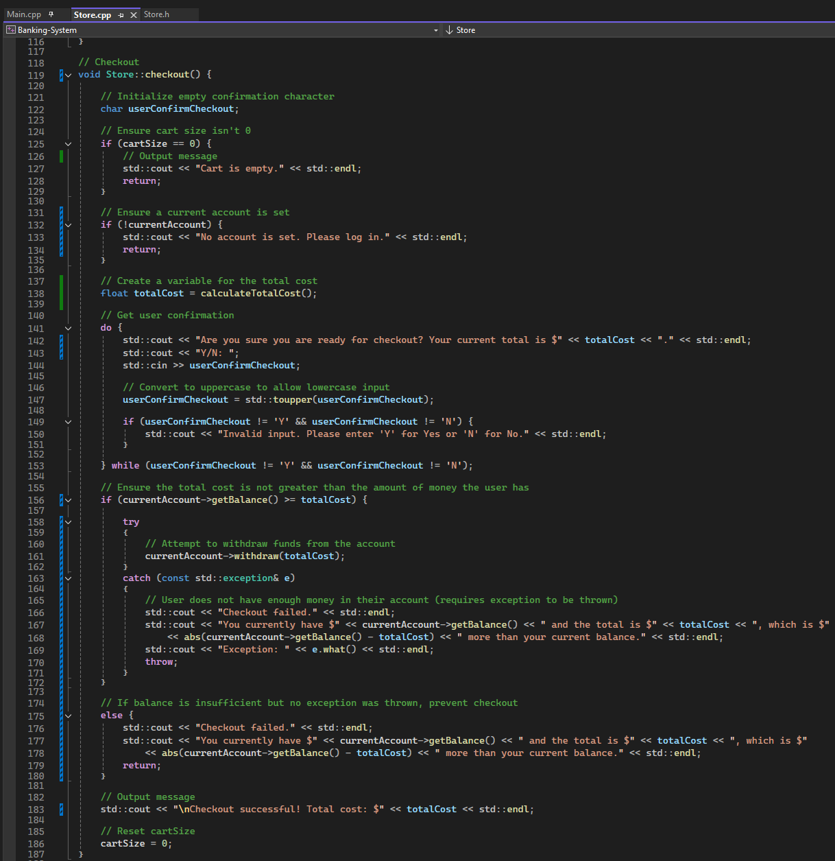
Section 5 Slide 9/13 Store.cpp part 3

Slide 39
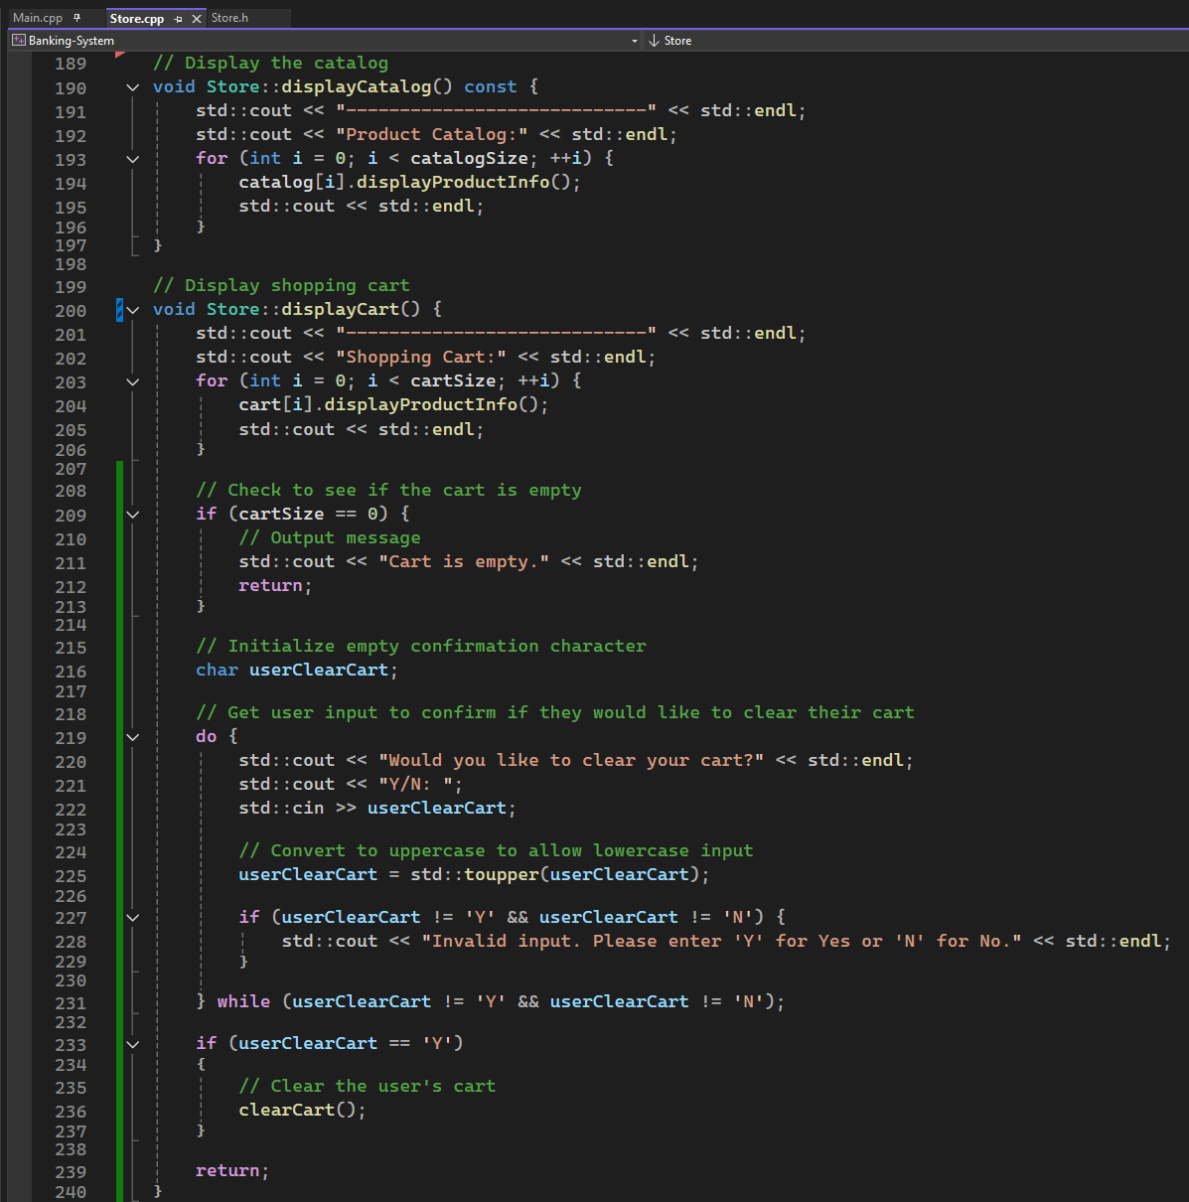
Section 5 Slide 10/13 Store.cpp part 4

Slide 40
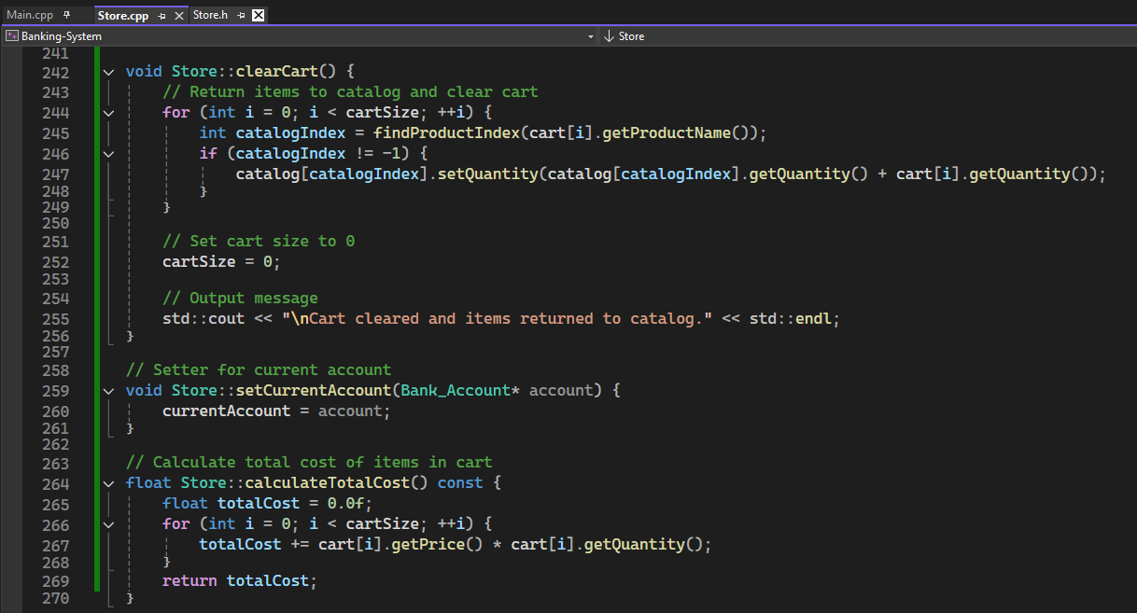
Section 5 Slide 11/13 Store.cpp part 5

Slide 41
Section 5 Slide 12/13 Store.cpp part 6
Store Class Implementation:
Manages store operations, including product inventory, shopping cart, and transactions.
Initialization:
Constructor sets "catalogSize", "cartSize", and initializes the product catalog.
"initializeCatalog()": Preloads predefined products.
Product Management:
"updateProductDetails()": Modifies product price and quantity.
"findProductIndex()": Retrieves product index in catalog.

Slide 42
Section 5 Slide 13/13 Store.cpp part 7
Store Class Implementation:
Manages store operations, including product inventory, shopping cart, and transactions.
Shopping Cart Operations:
Constructor sets "catalogSize", "cartSize", and initializes the product catalog.
"initializeCatalog()": Preloads predefined products.
Checkout Process:
Validates user account, confirms purchase, handles transaction errors.
"calculateTotalCost()": Computes total amount in the cart.
Store Interaction:
"displayCatalog()": Lists available products.
"setCurrentAccount()": Links store transactions to a bank account.

Slide 43
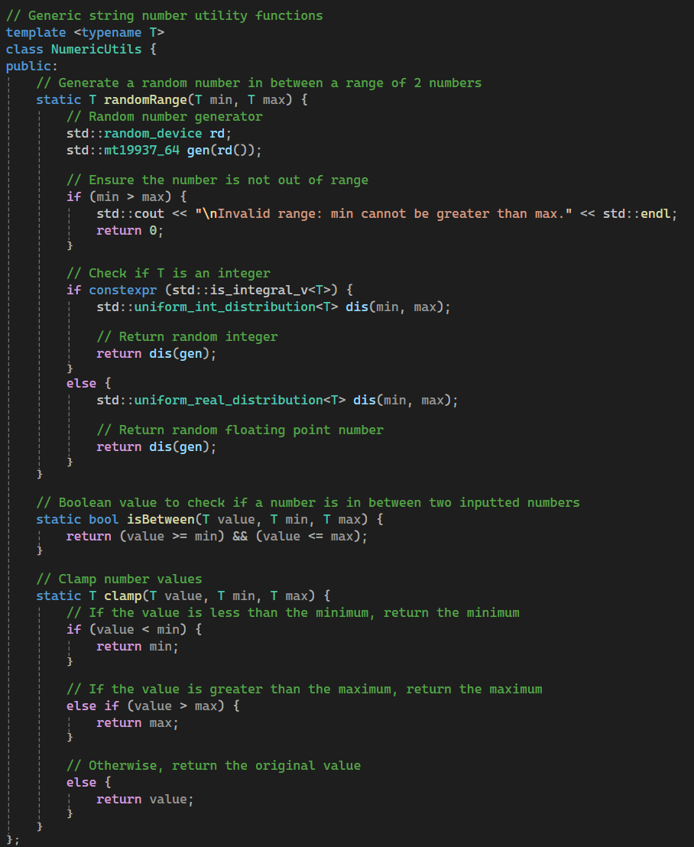
Section 6 Slide 1/18 NumericUTIls part 1

Slide 44
Section 6 Slide 2/18 NumericUTIls part 2
Template Class (NumericUtils<T>)
Allows numeric utility functions to work with different data types (int, float, double, etc.).

Slide 45
Section 6 Slide 3/18 NumericUTIls part 3
Random Number Generation (randomRange)
Uses std::random_device and std::mt19937_64 to create a random number generator.
If the minimum > maximum, an error message is displayed and 0 is returned.
Uses std::is_integral_v<T> to determine if T is an integer.- If T is an integer, generates a random number using std::uniform_int_distribution<T>.
If T is a floating-point type, uses std::uniform_real_distribution<T> instead.

Slide 46
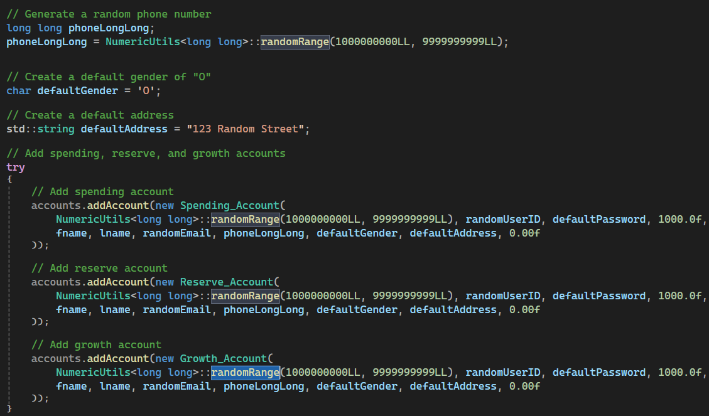
Section 6 Slide 4/18 NumericUTIls part 4

Slide 47
Section 6 Slide 5/18 NumericUTIls part 5
Range Validation (isBetween)
Checks whether a given value is between min and max inclusively.

Slide 48
Section 6 Slide 6/18 NumericUTIls part 6
Value Clamping (clamp)
If the value passed is less than the minimum, then it returns the minimum.
If the value is greater than maximum, then it returns the maximum.
Otherwise, the original value is returned.

Slide 49
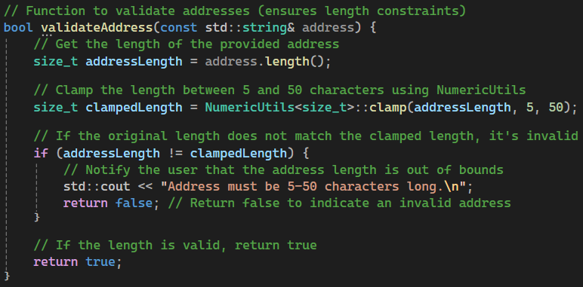
Section 6 Slide 7/18 NumericUTIls part 7

Slide 50
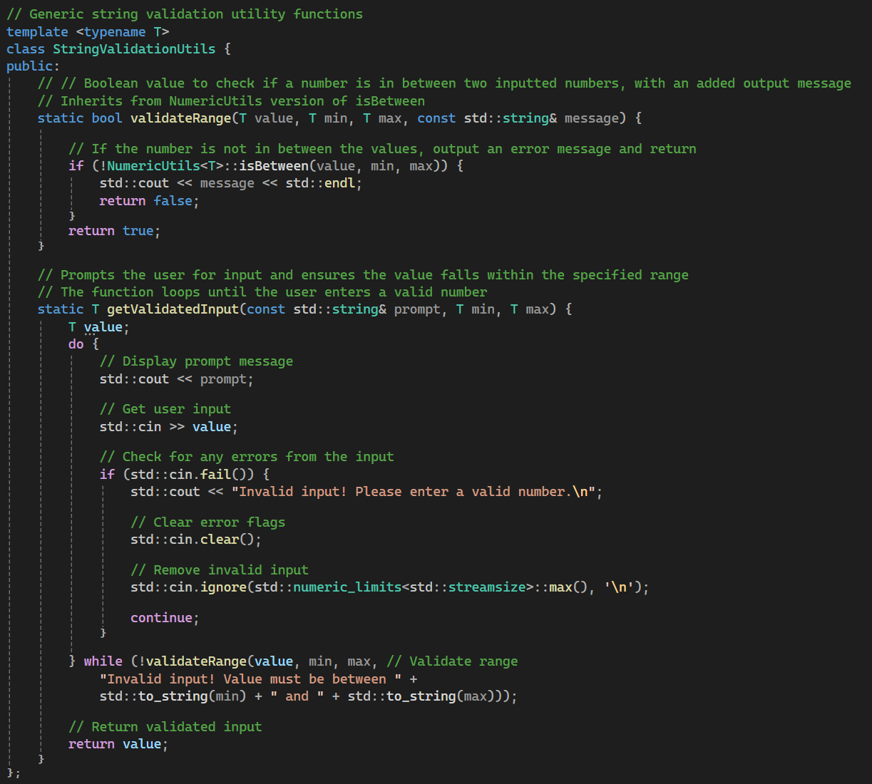
Section 6 Slide 8/18 StringValidationUtils part 1

Slide 51
Section 6 Slide 9/18 StringValidationUtils part 2
Template Class (StringValidationUtils<T>)
Designed to provide generic string validation utilities for different data types such as int, float, etc.

Slide 52
Section 6 Slide 10/18 StringValidationUtils part 3
Range Validation (validateRange)
Checks if a given value is between “min” and “max”.
Uses the “NumericUtils<T>::isBetween” function to determine validity.
If the value is out of range, displays the provided error message and returns “false”.
If valid, returns “true”.

Slide 53
Section 6 Slide 11/18 StringValidationUtils part 4
User Input Validation (getValidatedInput)
Continuously prompts the user for input until a valid number is entered.
Displays a custom prompt message to guide the user.
Reads user input using std::cin >> value.
Checks for input errors (std::cin.fail()):
If an error is found, an invalid input message is displayed.
Clears error flags using std::cin.clear().
Ignores any invalid input to prevent further issues (std::cin.ignore()).
Uses validateRange to ensure the entered value falls within the required range.
Returns the validated user input.

Slide 54
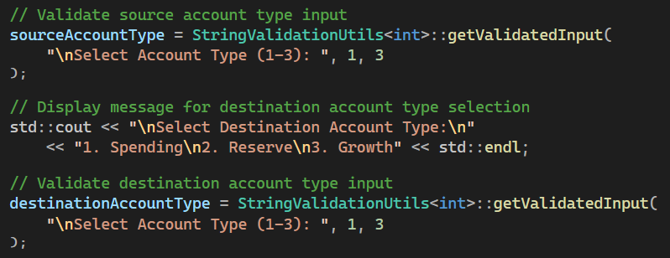
Section 6 Slide 12/18 StringValidationUtils part 5

Slide 55
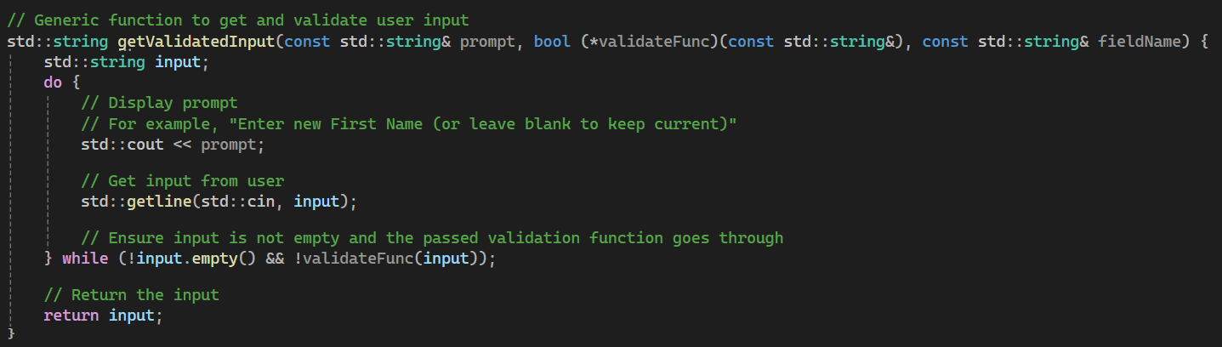
Section 6 Slide 13/18 getValidatedInput part 1

Slide 56
Section 6 Slide 14/18 getValidatedInput part 2
Generic Function (getValidatedInput)
Parameters:
Prompt: A string displayed to the user as a prompt.
validateFunc: A function pointer that takes a string and returns a boolean, determining if the input is valid.
fieldName: A string representing the name of the field being validated (though it’s not actually used in the function).
Steps in Execution:
Initialize Input: A string variable input is created to store user input.
Loop Until Valid Input: A dowhile loop ensures validation checks only when the user enters something.
Display Prompt: The std::cout statement prints the prompt message to guide the user.
Get User Input: std::getline(std::cin, input) retrieves input from the user.
Validate the Input: If the input is not empty, it gets passed to the validateFunc, and the loop runs again if validation fails.
Return the Validated Input: Once the loop exits, the input is returned.

Slide 57
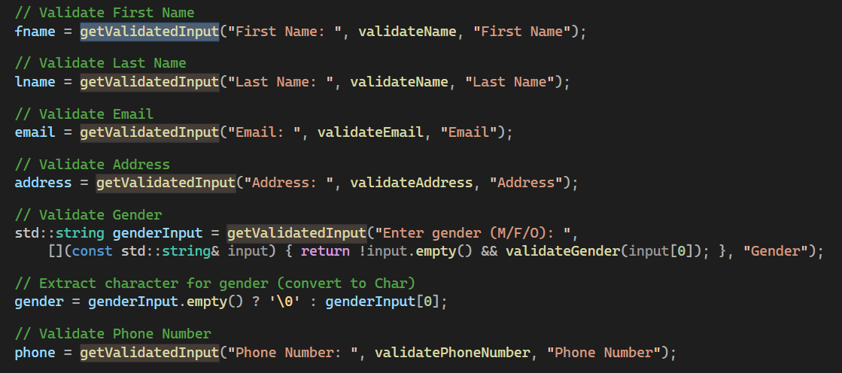
Section 6 Slide 15/18 getValidatedInput part 3
In “void createAccount(AccountList& accounts)”

Slide 58
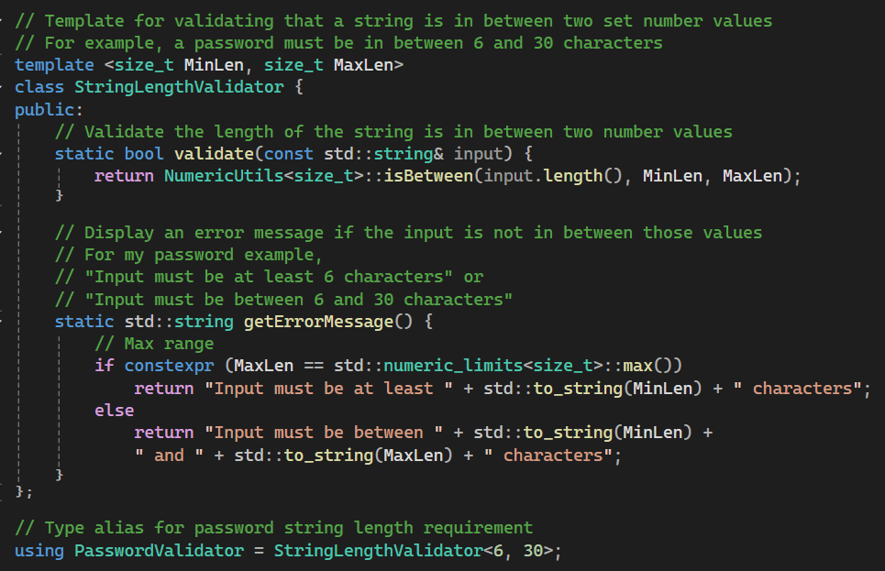
Section 6 Slide 16/18 StringLengthValidator part 1

Slide 59
Section 6 Slide 17/18 StringLengthValidator part 2
StringLengthValidator()
Enforces length constraints for strings, ensuring they meet minimum and maximum requirements.
Uses template parameters to define flexibility, allowing customizable length validation.
Provides a validation method (validate) to check if the string length falls within the specified range.
Offers a dynamic error message function (getErrorMessage) that adjusts based on defined limits.
If the maximum limit is unrestricted, only the minimum length is enforced in the error message.
Otherwise, both minimum and maximum constraints are clearly communicated to the user.
Defines a passwordspecific alias (PasswordValidator) for enforcing a 6–30-character limit on passwords.

Slide 60
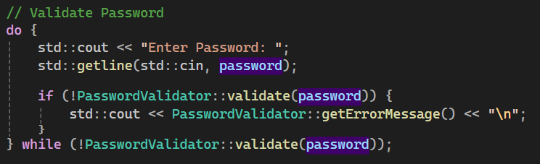
Section 6 Slide 18/18 StringLengthValidator part 3

Slide 61

THANK YOU
Thomas Hatt

